Slide 1
2nd Grade Art Studio
2021

Slide 2
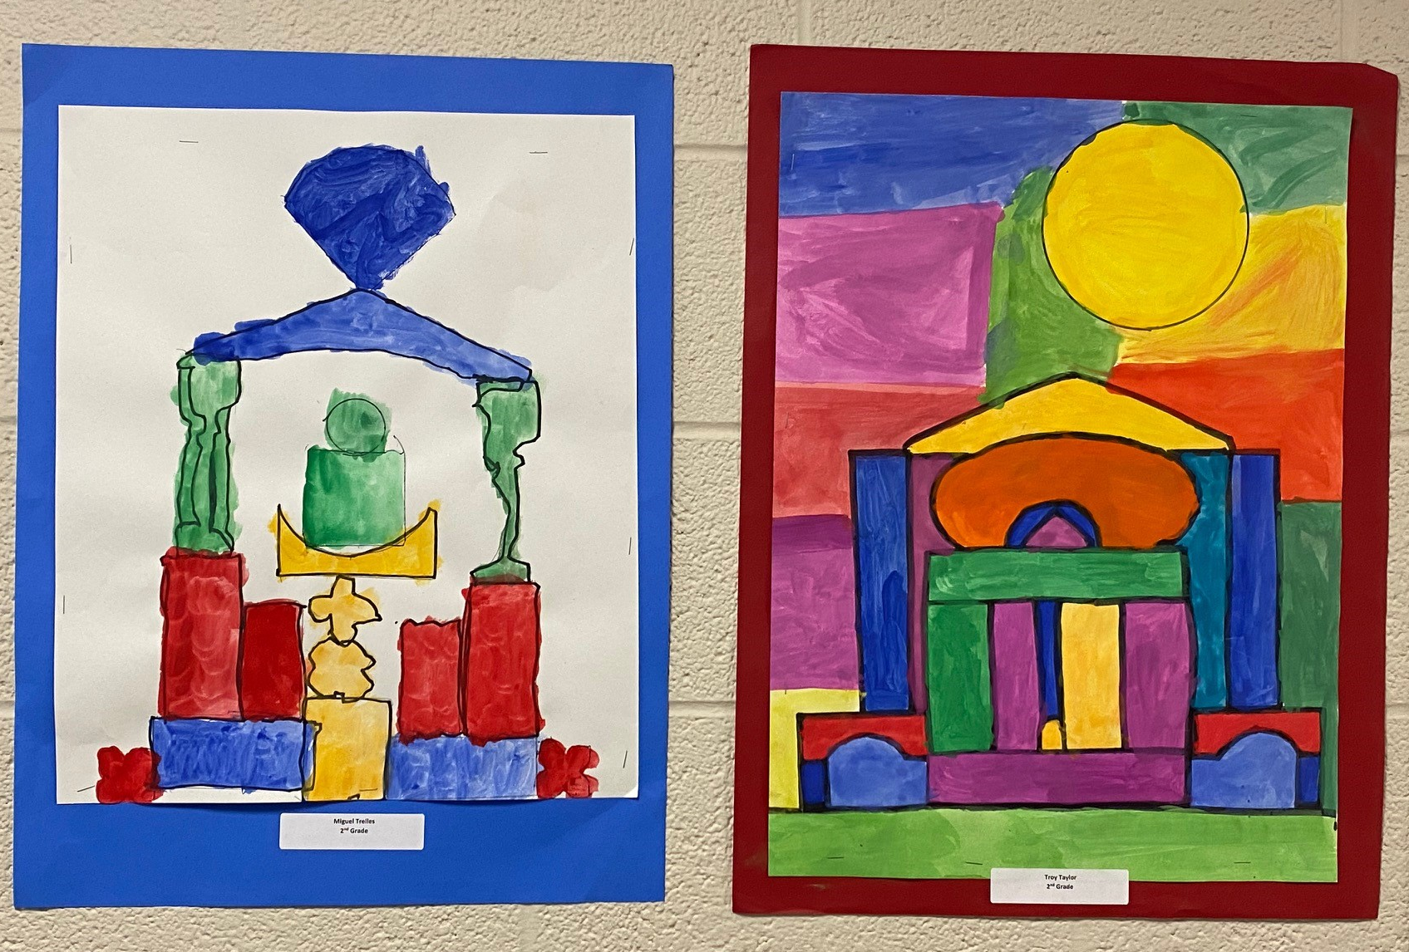
Miguel Trelles
Troy Taylor

Slide 3
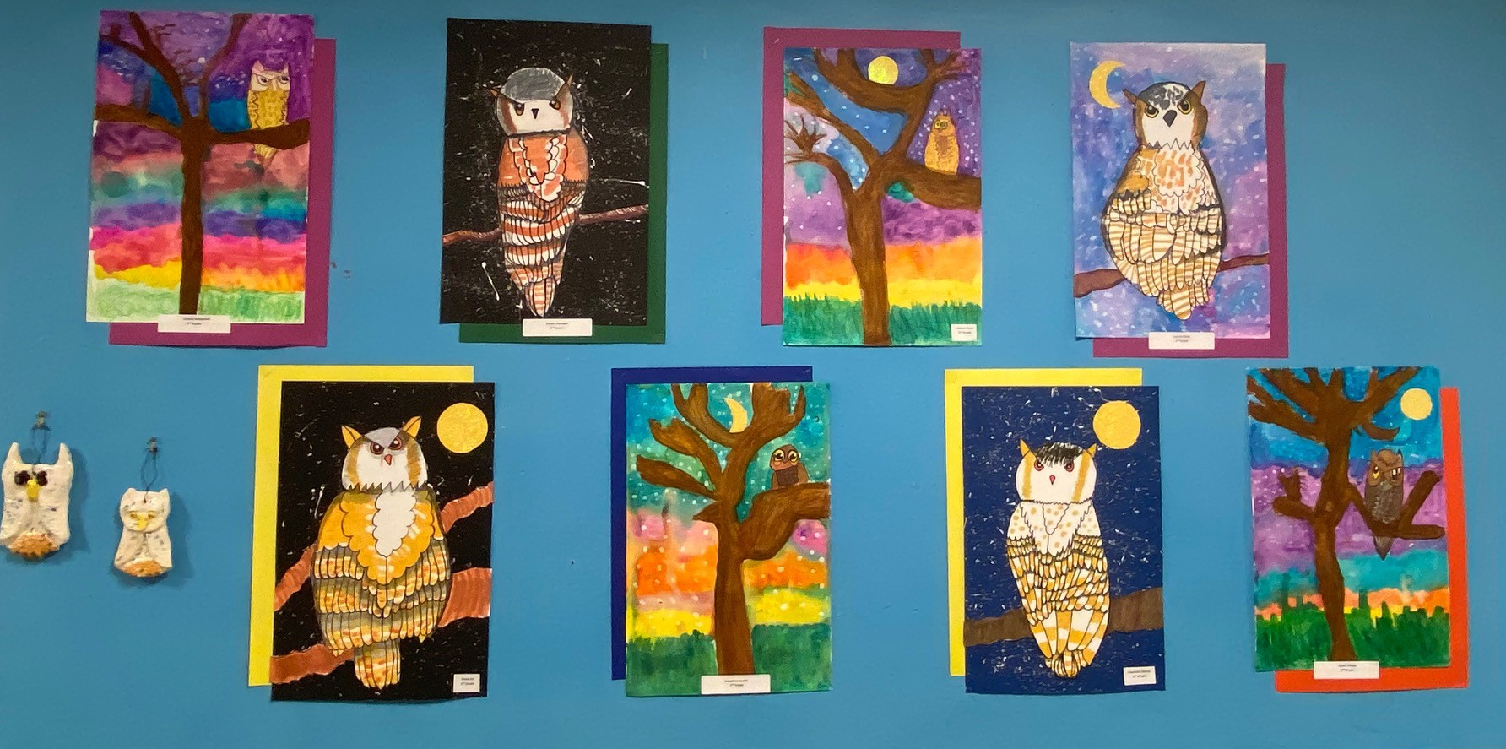
Bryson Kinkoph
Valeria Pena
Lauren Rowe
Evelina Smiecinski
Fiona He
Josephine Austin
Charlotte Darling
Ayaan Siddiqi

Slide 4
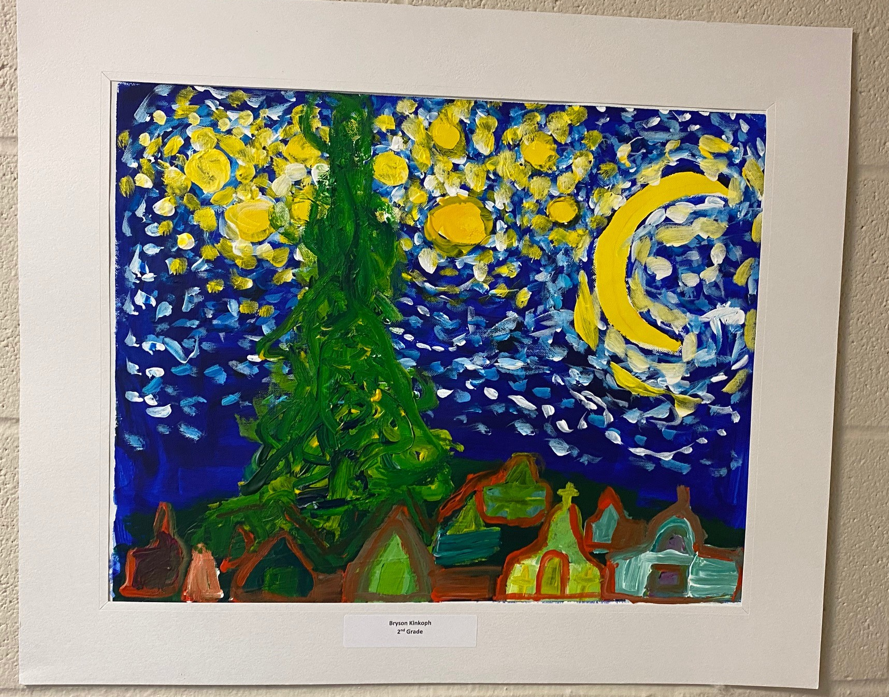
Bryson Kinkoph

Slide 5
Josephine Austin
Jared Kang

Slide 6
Rebecca Smith
Troy Taylor

Slide 7
Ayaan Siddiqi
Grace Becker

Slide 8
Evelina Smiecinski
Valeria Pena

Slide 9
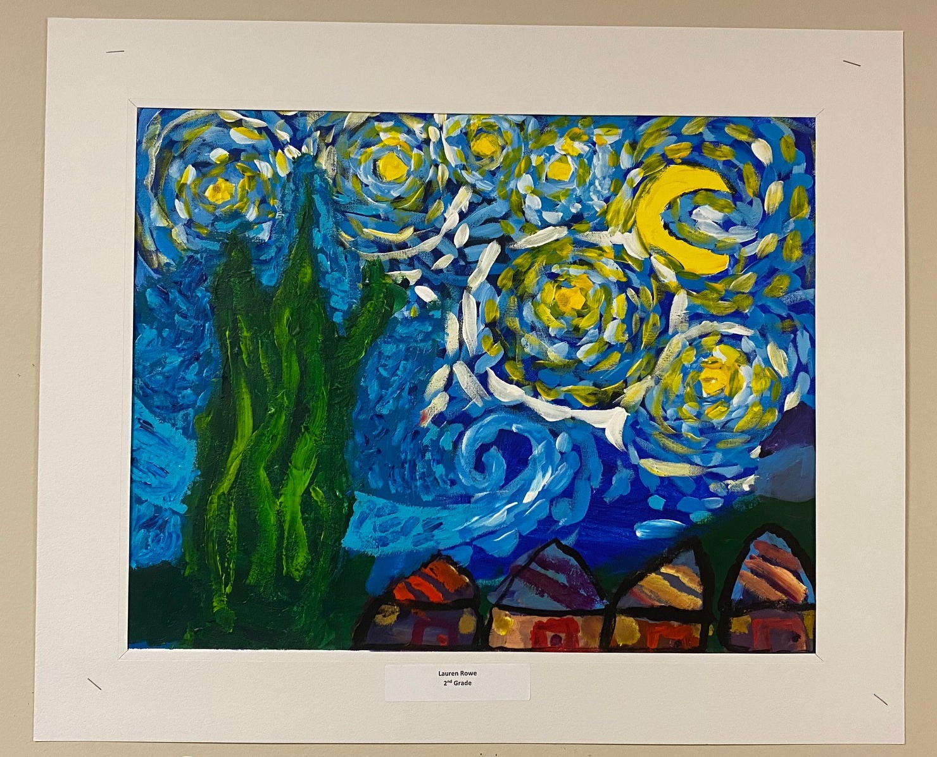
Lauren Rowe

