Slide 1
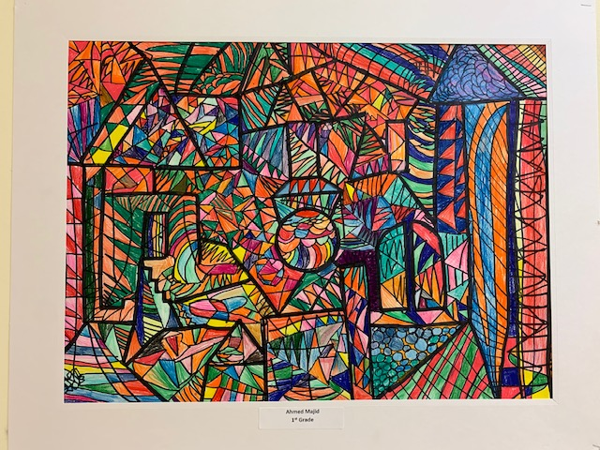
FIRST GRADE
ARTISTRY
Arts Walk 2021
Title image by
Ahmed
Majid, Grade 1
(year-long
Project)

Slide 2
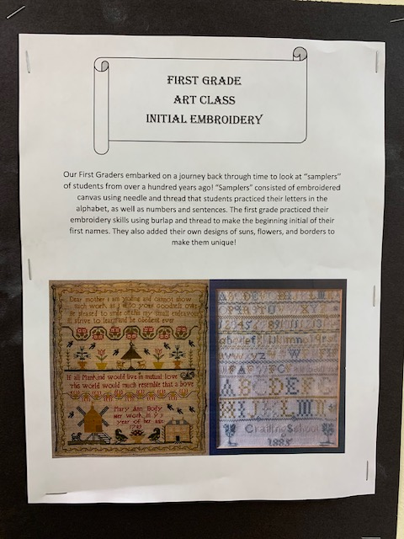

Slide 3
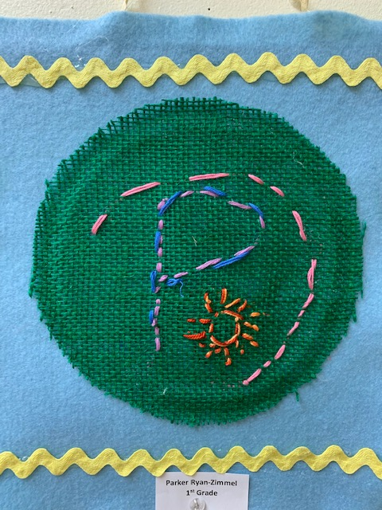
Parker Ryan-Zimmel

Slide 4
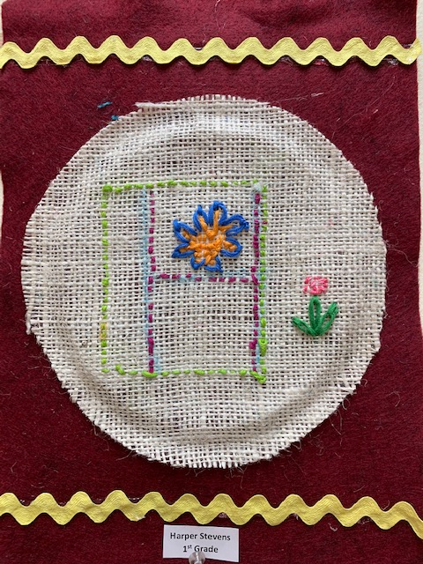
Harper Stevens

Slide 5
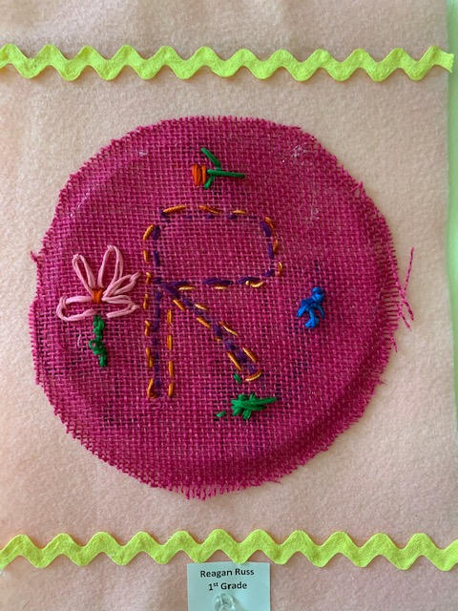
Reagan Russ

Slide 6
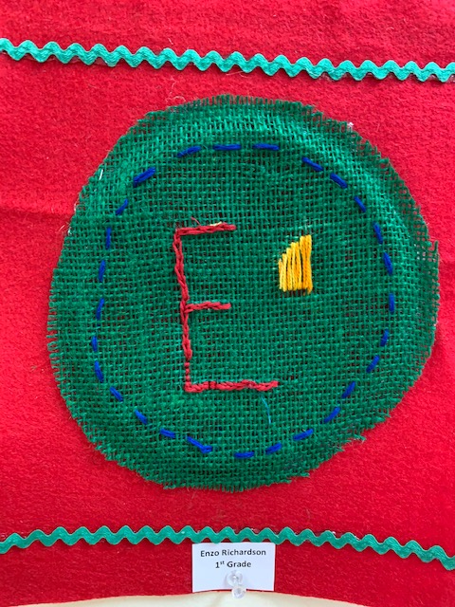
Enzo Richardson

Slide 7
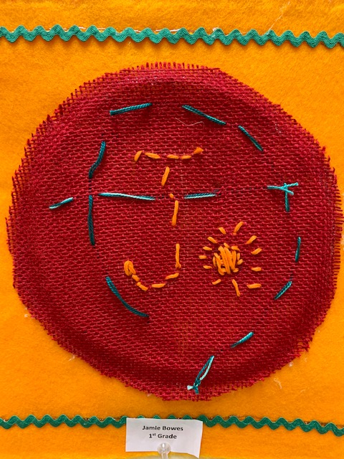
Jamie Bowes

Slide 8
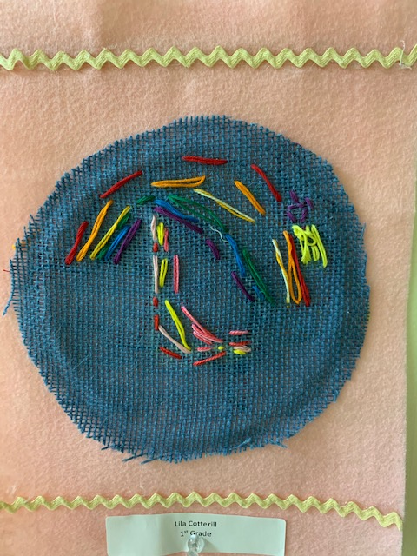
Lila Cotterill

Slide 9
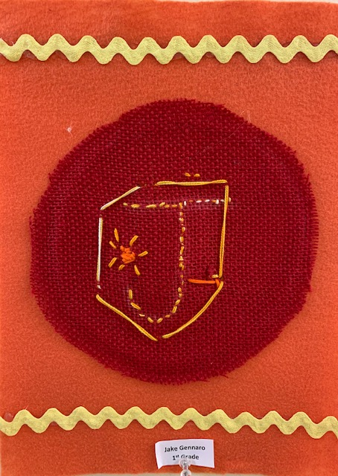
Jake Gennaro

Slide 10
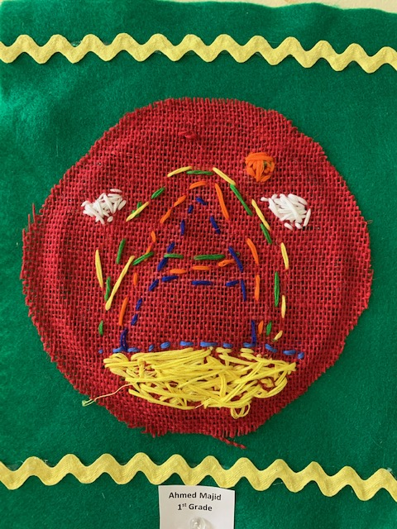
Ahmed Majid

Slide 11
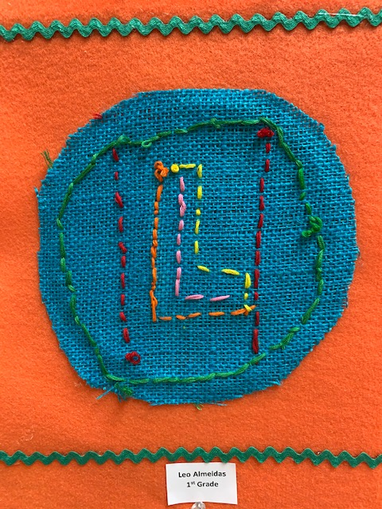
Leo Almeida

Slide 12
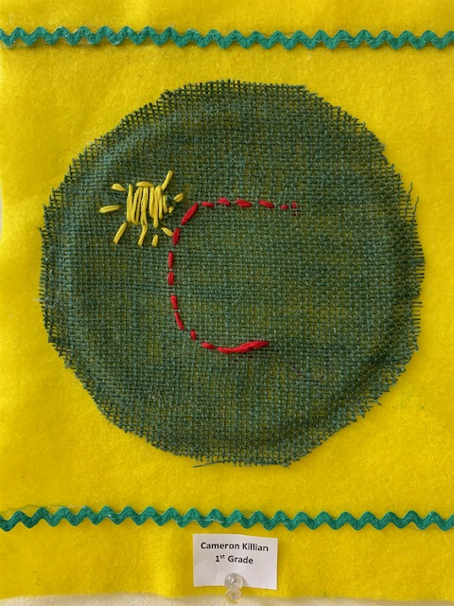
Cameron Killian

Slide 13
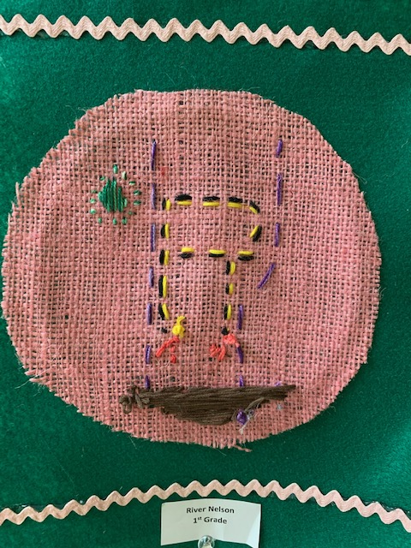
River Nelson

Slide 14
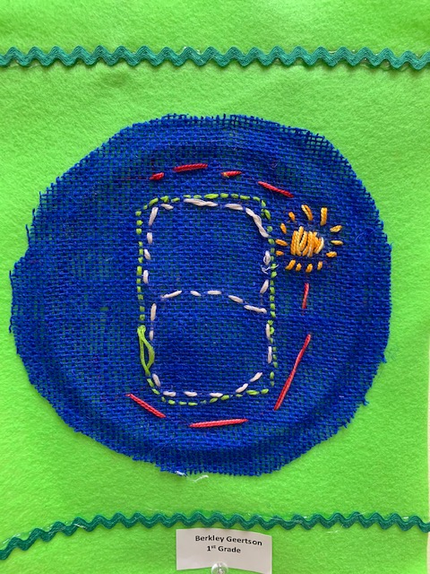
Berkley Geertson

Slide 15
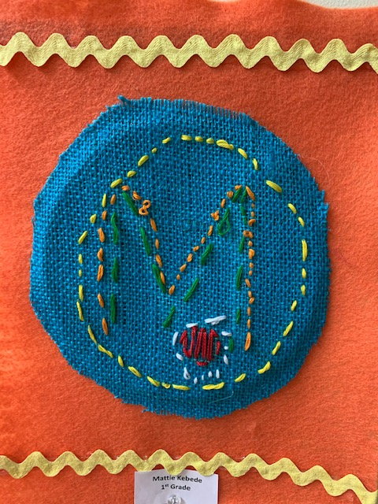
Matheos Kebede

Slide 16
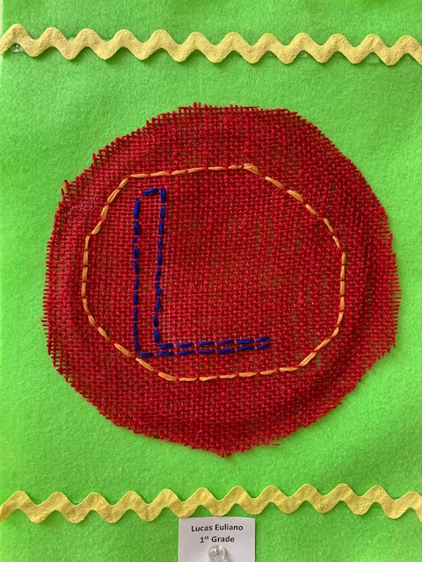
Lucas Euliano

Slide 17
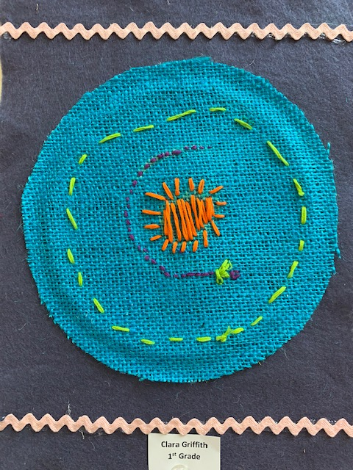
Clara Griffith

Slide 18
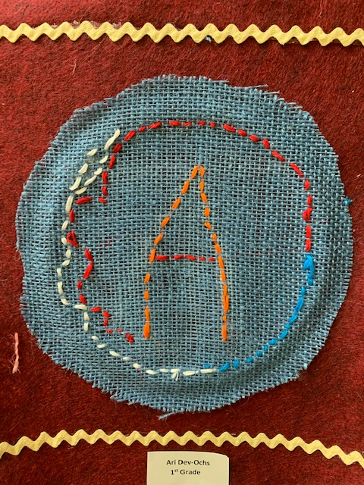
Arianika Dev-Ochs

Slide 19
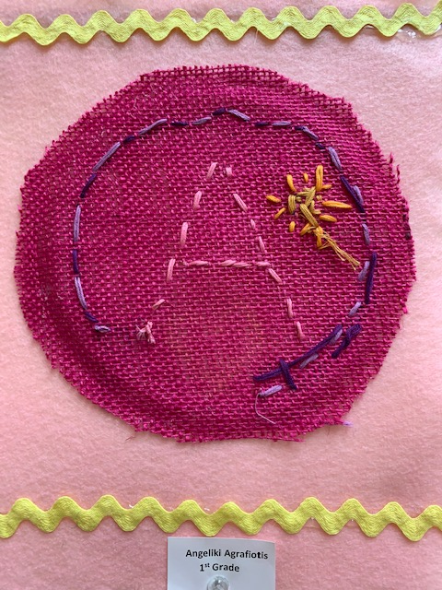
Angeliki Agrafiotis

Slide 20
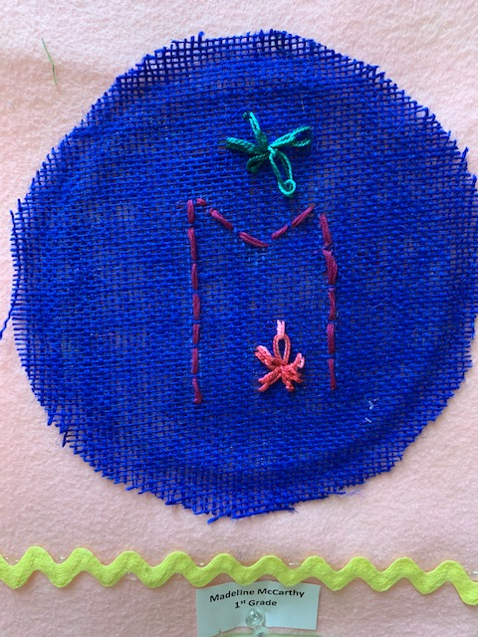
Madeline McCarthy

Slide 21
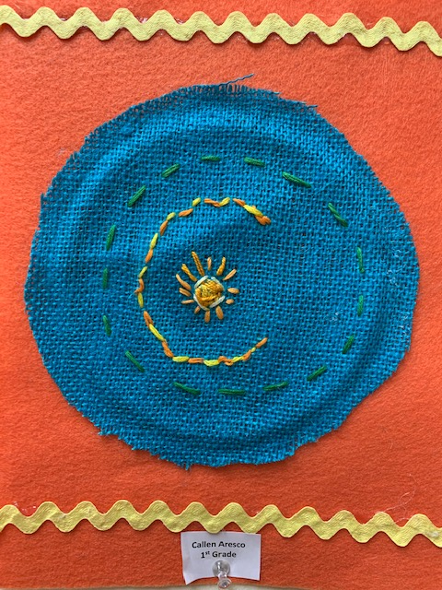
Callen Aresco

Slide 22
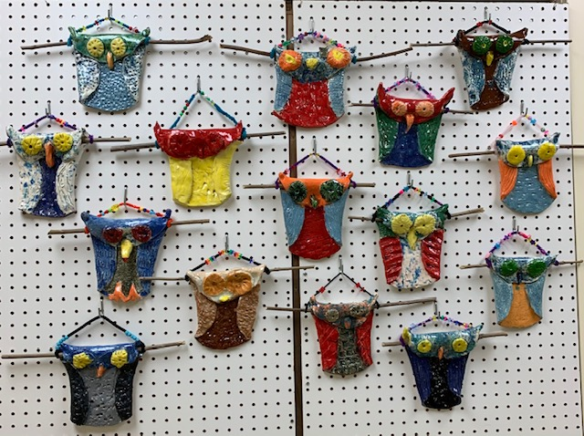
Thank you for viewing our artwork!

