Slide 1
First Grade Artistry
Arts Walk 2021

Slide 2
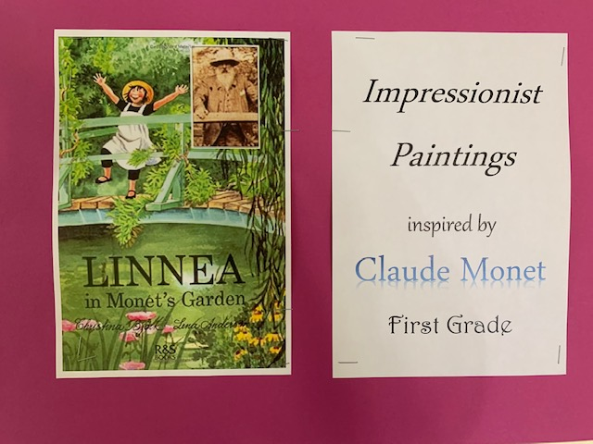

Slide 3
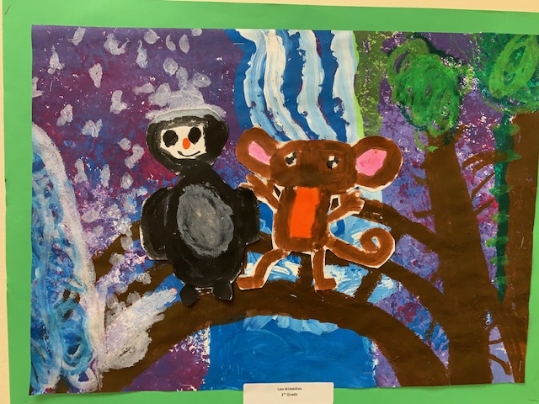
Leo Almeida

Slide 4
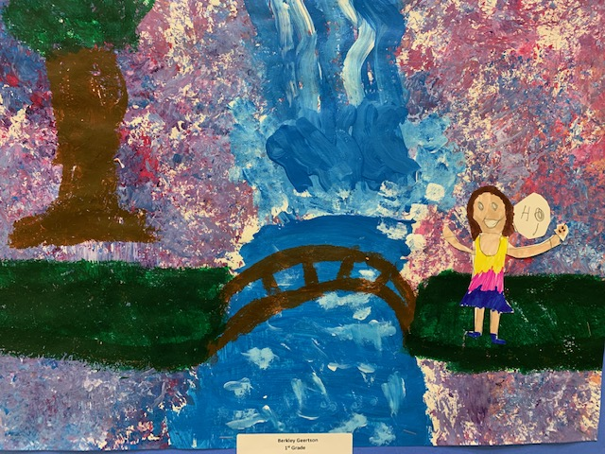
Berkley Geertson

Slide 5
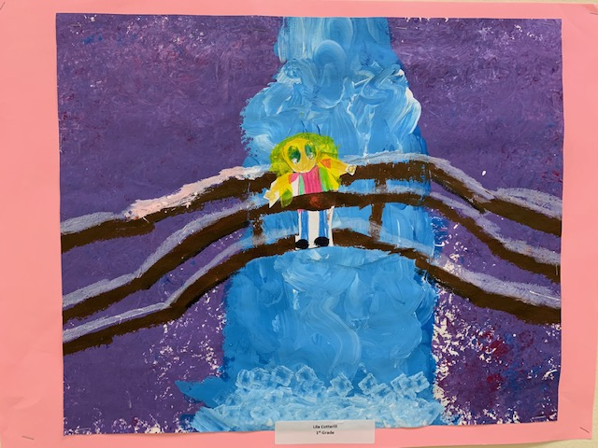
Lila Cotterill

Slide 6
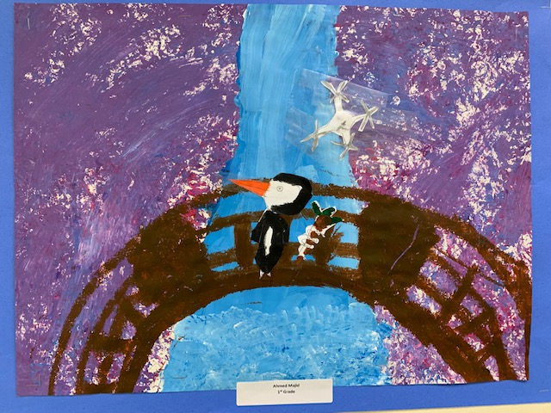
Ahmed Majid

Slide 7
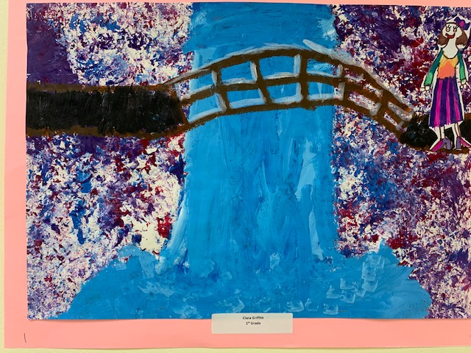
Clara Griffith

Slide 8
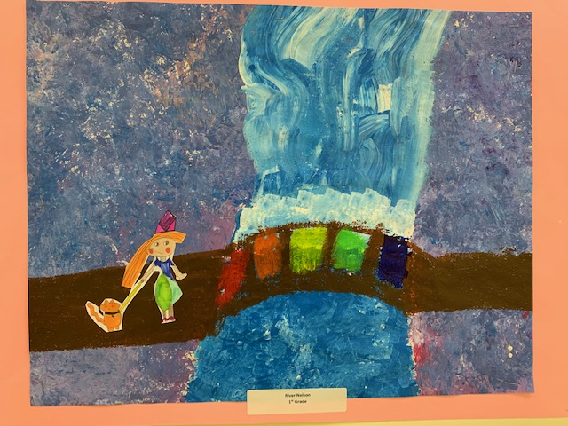
River Nelson

Slide 9
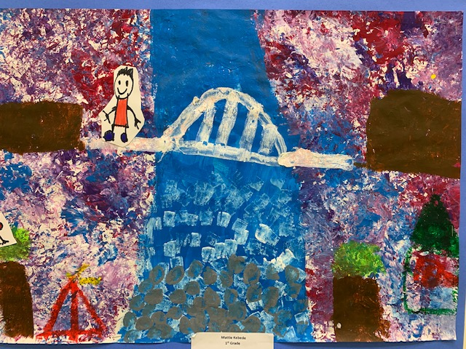
Matheos Kebede

Slide 10
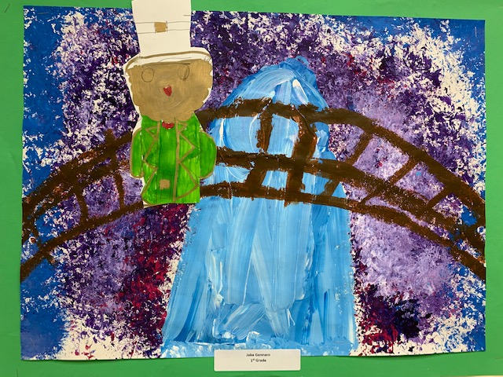
Jake Gennaro

Slide 11
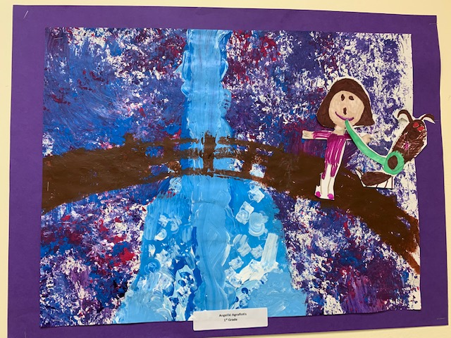
Angeliki Agrafiotis

Slide 12
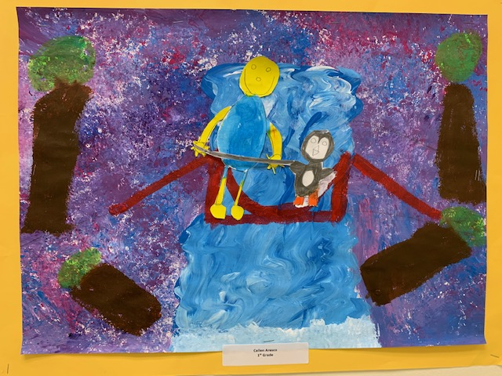
Callen Aresco

Slide 13
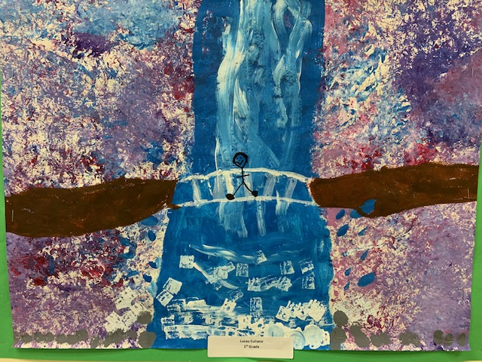
Lucas Euliano

Slide 14
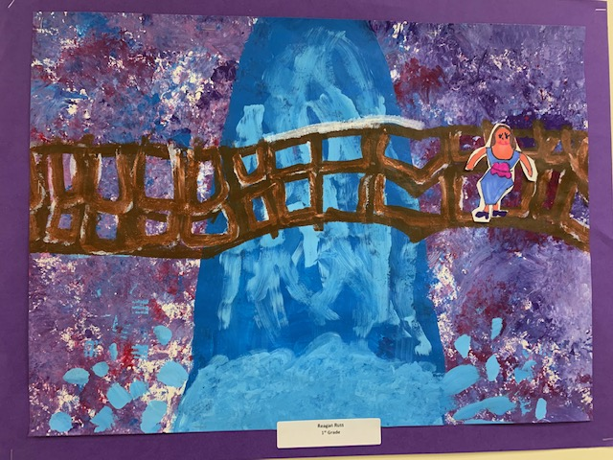
Reagan Russ

Slide 15
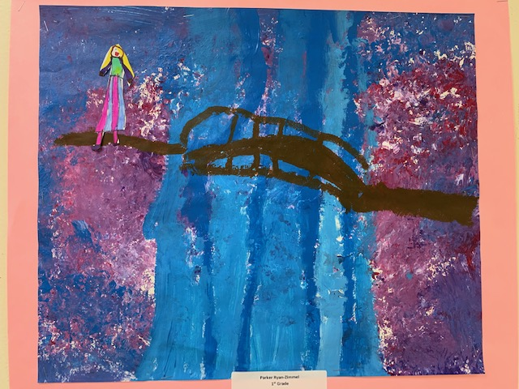
Parker Ryan-Zimmel

Slide 16
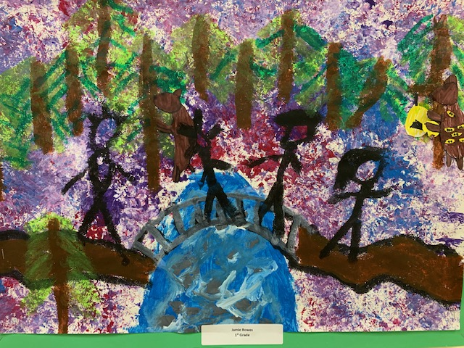
Jamie Bowes

Slide 17
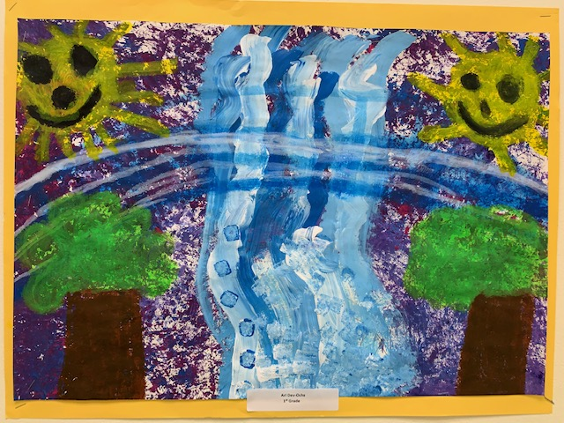
Arianika Dev-Ochs

Slide 18
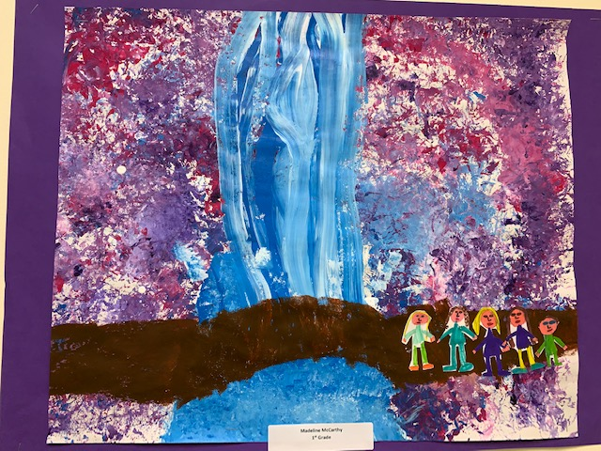
Madeline McCarthy

Slide 19
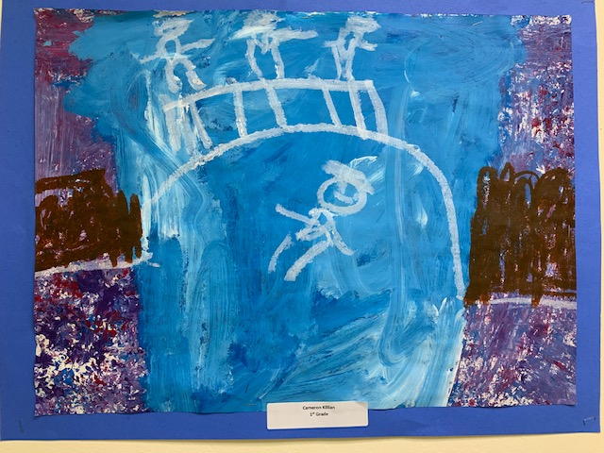
Cameron Killian

Slide 20
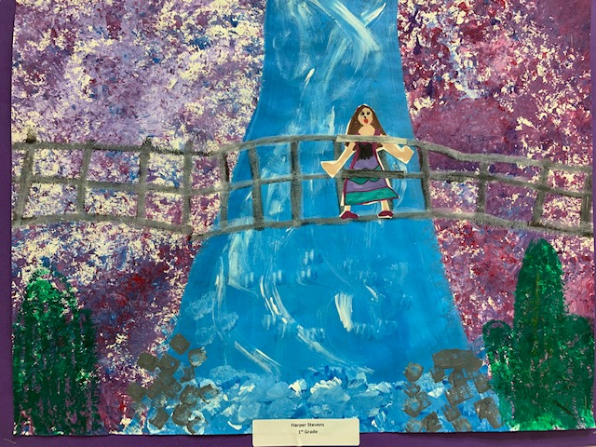
Harper Stevens

Slide 21
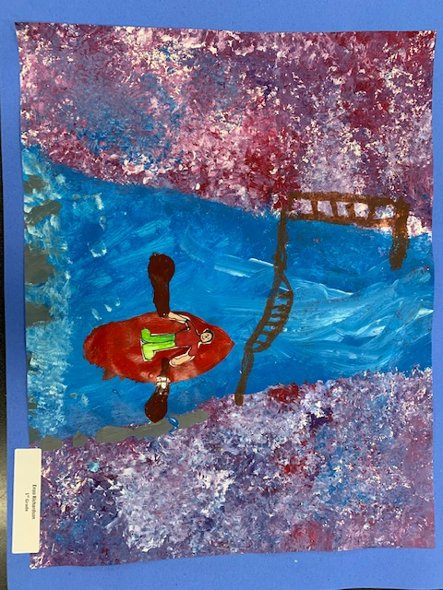
Enzo Richardson

