Slide 1
FIRST GRADE ARTISTRY
Arts Walk 2021

Slide 2
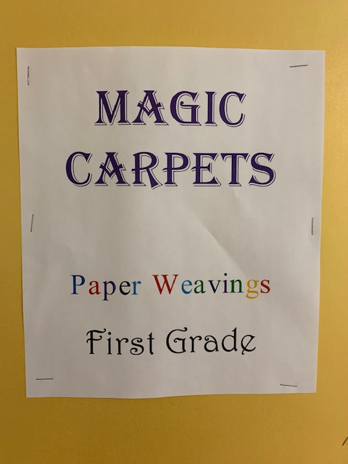

Slide 3
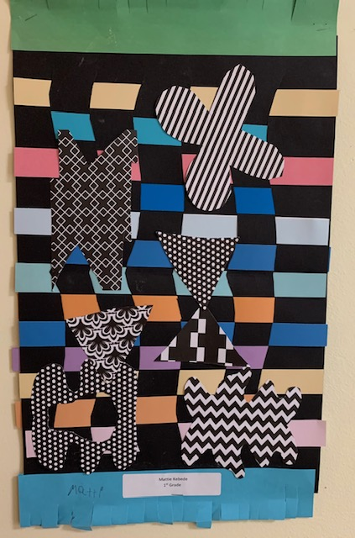
Matheos Kebede

Slide 4
Angeliki Agrafiotis

Slide 5
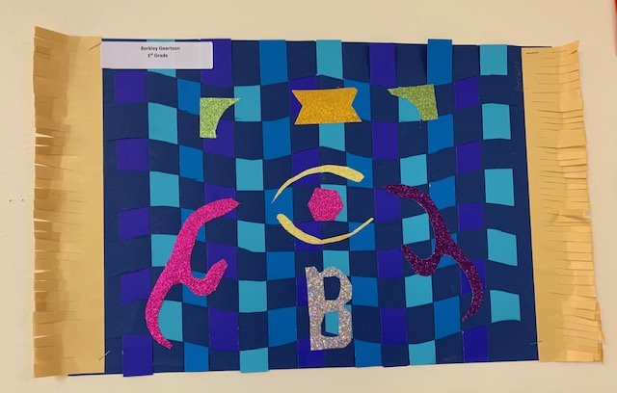
Berkley Geertson

Slide 6
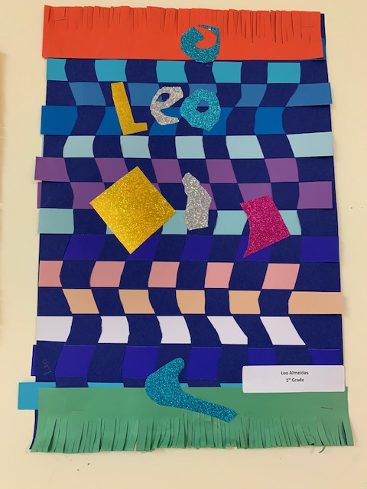
Leo Almeida

Slide 7
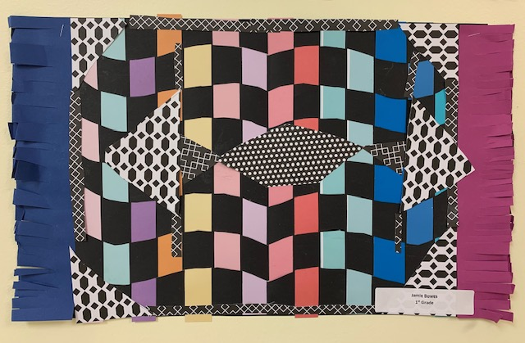
Jamie Bowes

Slide 8
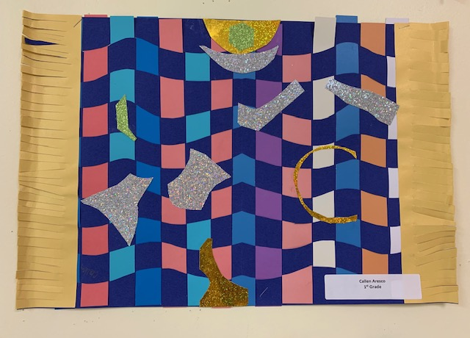
Callen Aresco

Slide 9
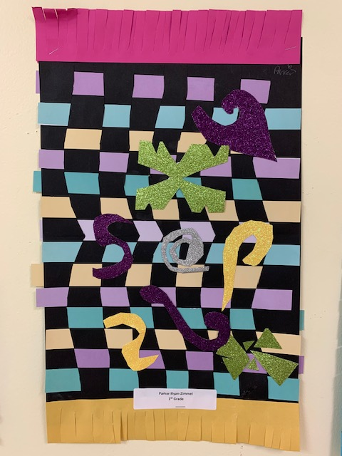
Parker Ryan-Zimmel

Slide 10
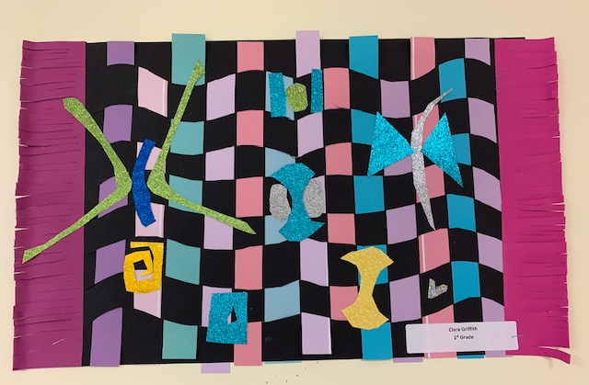
Clara Griffith

Slide 11
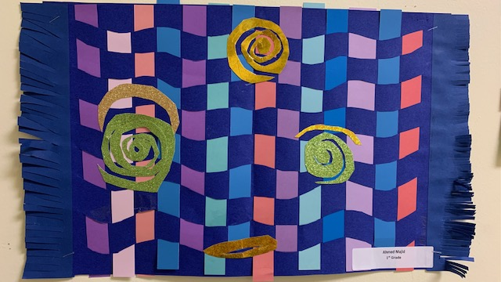
Ahmed Majid

Slide 12
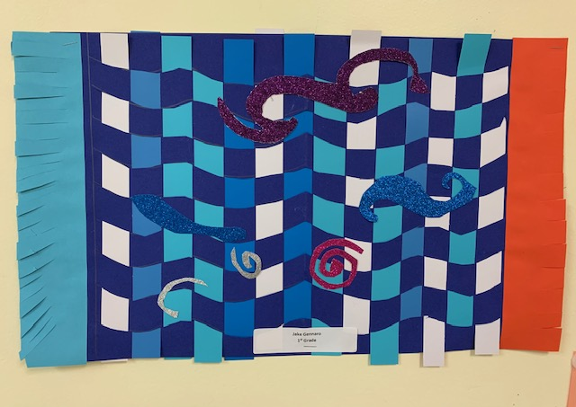
Jake Gennaro

Slide 13
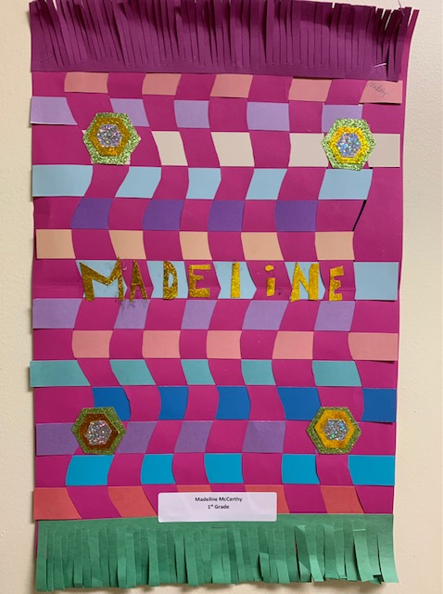
Madeline McCarthy

Slide 14
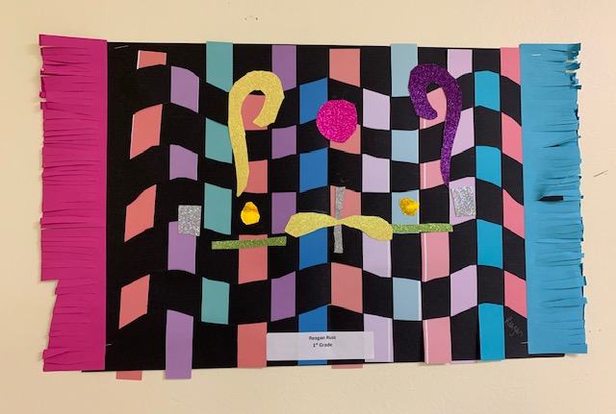
Reagan Russ

Slide 15
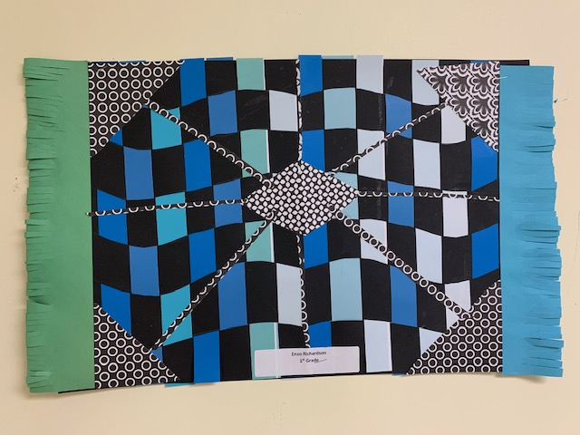
Enzo Richardson

Slide 16
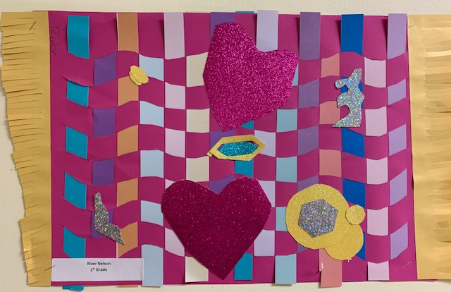
River Nelson

Slide 17
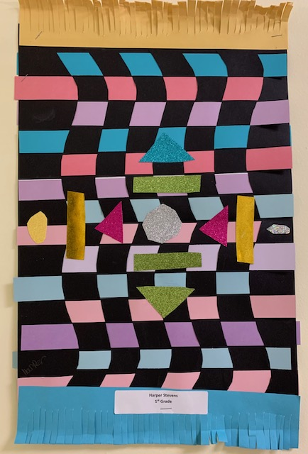
Harper Stevens

Slide 18
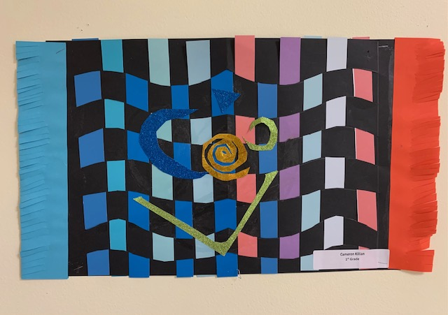
Cameron Killian

Slide 19
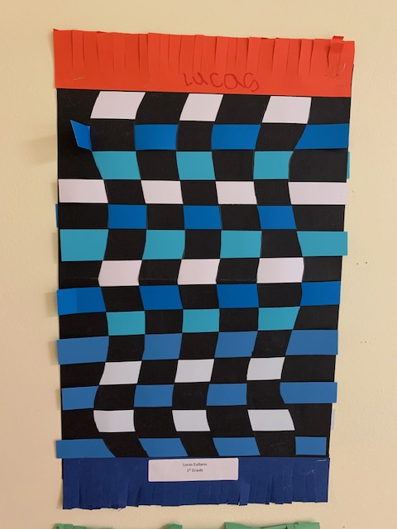
Lucas Euliano

Slide 20
